Slide 1
Practicing After Covid-19 What did we Learn?
RANDY J. CURATO Vice President—Senior Loss Prevention Counsel, ALAS
Bruce Stone Goldman Felcoski & Stone, P.A. Florida
Ryan J. SzcZepanik Hartog, Baer & Hand, ApC

Slide 2
Rules still apply
New challenges
New technology
New approaches to discovery, dispute resolution, and trials
Bruce…
Lessons learned
The future
Underwriting loss of $19.9 million, solidly beating projections
Claims frequency of 5.6 real claims per 1,000 lawyers, lowest in our history
Severity decreased to $3.64 million per incurred claim, lowest in nine years
$174.1 million investment return
Today’s agenda

Slide 3
Rules still apply
Competence
Communication
Confidentiality
Diligence
Supervision
Underwriting loss of $19.9 million, solidly beating projections
Claims frequency of 5.6 real claims per 1,000 lawyers, lowest in our history
Severity decreased to $3.64 million per incurred claim, lowest in nine years
$174.1 million investment return
The Rules

Slide 4
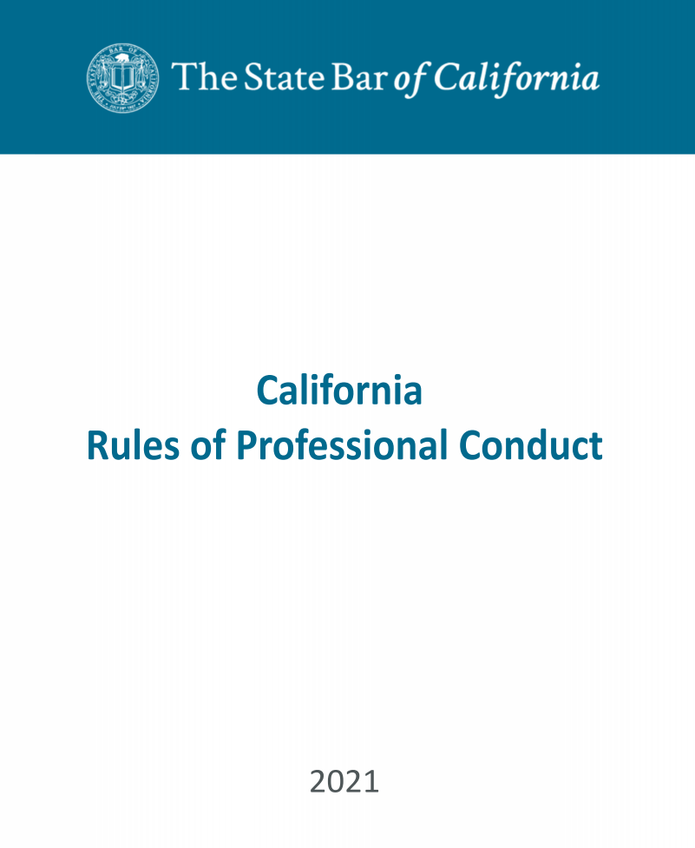
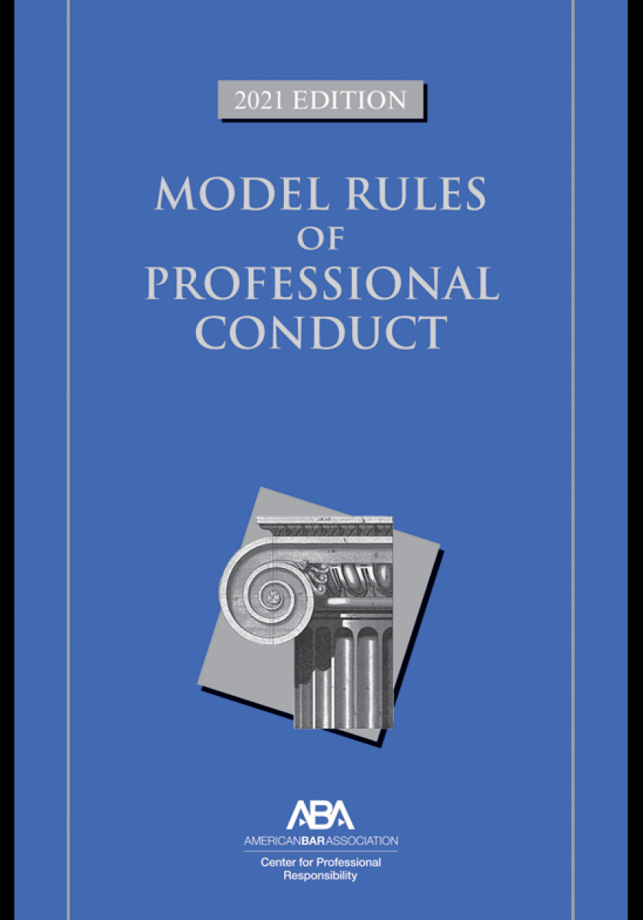
The Rules Still Apply

Slide 5
Competence
CA Comment [1] The duties set forth in this rule include the duty to keep abreast of the changes in the law and its practice, including the benefits and risks associated with relevant technology.
ABA Comment [8] To maintain the requisite knowledge and skill, a lawyer should keep abreast of changes in the law and its practice, including the benefits and risks associated with relevant technology, engage in continuing study and education and comply with all continuing legal education requirements to which the lawyer is subject.

Slide 6
New Technology
New devices
Zoom and other video platforms
Echo, Alexa, and other personal “assistants”
Video notarization
Video hearings, depositions, trials
Texting

Slide 7
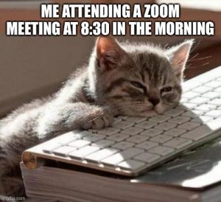
Zooma Zooma Zoom
Chat to/from client visible to all
Regrettable comments thinking mute was on
Sharing wrong screen
Second call; heard by all
Court hearing handled in bed
Bathroom trip on video
Suit waist up; boxers below— or nothing on at all
Visible lack of interest
Unwelcome room entrant
Stuffed animals in background
RECORDING?
FILTER?

Slide 8
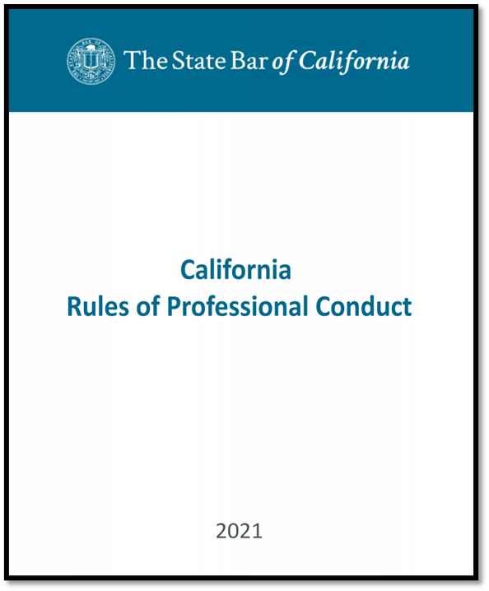
Confidentiality
Model Rule 1.6 (a) A lawyer shall not reveal information relating to the representation of a client unless the client gives informed consent, the disclosure is impliedly authorized in order to carry out the representation or the disclosure is permitted by paragraph (b).
CA Rule 1.6. A lawyer shall not reveal information protected from disclosure by Business and Professions Code section 6068, subdivision (e)(1) unless the client gives informed consent,* or the disclosure is permitted by paragraph (b) of this rule. [BPC 6068 (e): (1)To maintain inviolate the confidence, and at every peril to himself or herself to preserve the secrets, of his or her client.]

Slide 9
Privileged
CONFIDENTIAL
Goes beyond privilege
Notes:
Here’s the first wrinkle. The duty of confidentiality goes beyond the information that is covered by the attorney-client privilege. So even documents that aren’t marked “privileged” may be considered “confidential” under the professional conduct rules.
The professional conduct rules on this issue are not a model of clarity and they can vary from jurisdiction to jurisdiction. But one thing is clear — they all take a pretty broad view of confidentiality.

Slide 10
Confidentiality Risks
Overheard conversations
Documents on desk, open on device
Papers in wastebasket
Devices accessible to others

Slide 11
Communication and Diligence
Rule 1.3 Diligence
Rule 1.4 Communication

Slide 12
Supervision
Rule 5.1 Supervision of other lawyers
Rule 5.3 Supervision of nonlawyers

Slide 13
DEPOSITIONS
Video depositions are likely here to stay
Hard skills: how to maneuver the technology and ensure the correct bandwidth
Soft skills: how to read and connect with the deponent
The importance of admonitions and being observant – e.g., no chat screens or texting by the deponent!

Slide 14
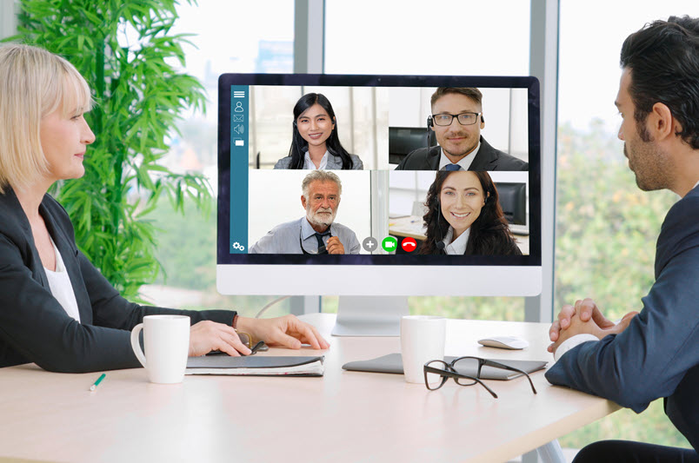
MEDIATION
Zoom mediations are likely here to stay
No travel time and expense
Court backlogs increase the appeal of giving mediation a go
Private trials if mediation not successful

Slide 15
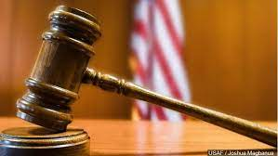
TRIALS
The future of trials: likely a hybrid approach
Some witnesses in person, some by video
Cal. Senate Bill 241: witness may appear at court by electronic means by stipulation or party’s motion
Examining by video: can see straight into witness face, as opposed to across courtroom
The jury is still out on the future of jury trials

Slide 16
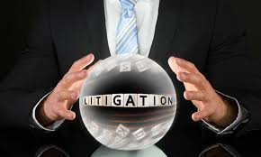
LITIGATION TAKE AWAYS
Remote technology is on balance a plus: it will broaden the universe of witnesses and decrease expense
Trial lawyers must stay abreast of changing state and local court rules
Practice makes perfect: learn the technology and how to use it with witnesses and exhibits

Slide 17
Wills, Trusts, and Other Estate Planning Documents: What Have We Learned?
We don’t really have to meet with existing or prospective clients in our offices anymore! (Ok, maybe we sort of knew that already.)
We can email drafts of documents to clients (but we already knew that).
We can go over our draft documents remotely with our clients in real time by screen sharing (honestly, most of us didn’t know how to do that before Zoom came along).
And we don’t have to meet with our clients for execution of their estate planning documents! (Wait! Is that really true?)

Slide 18
Electronic Wills: where are they allowed?
Nevada (2001 and 2017) fully remote execution allowed
Indiana (2018) execution allowed only in person
Arizona (2019) execution allowed only in person
Florida (2019) fully remote execution allowed
Utah (2020) (UEWA) fully remote execution allowed
North Dakota (2021) (UEWA) unclear if remote execution is allowed
Colorado (2021) (UEWA) fully remote execution allowed
Perhaps in many states by common law but only if executed in person

Slide 19
UEWA? What is that?
Uniform Electronic Wills Act: approved by the National Conference of Commissioners on Uniform States Laws, July 2019
An electronic will may be executed with the testator and all of the necessary witnesses present in one physical location.
An electronic will is also valid if the witnesses are in the electronic presence of the testator. The witnesses and testator must be able to communicate in “real time,” a term that means “the actual time during which something takes place.” The term is used in connection with electronic communication to mean that the people communicating do so without a delay in the exchange of information.

Slide 20
Que sera, sera: the future IS ours to see!
How will we meet with clients in the future? Do we really need offices?
How will estate planning documents be executed in the future?
How will new client relationships be established in the future?
How will we mentor our junior lawyers and legal assistants?
How can we maintain a balance between our work and private lives?
Artificial Intelligence: is the final frontier?

